Slide 1
What is a Brinicle?
Why are we modeling this?
Expected Results (Length v. Time)
How are we modeling this?
What is a Point Model
What is Diffusion?
Week 1 Cube code video
What is advection?
Week 2 Bar code video
How does our model work?
Brine Advection Based on Salinity
Diffusion Barrier on Salt due to Ice
Advection Rate Based on Salt Concentration
Freezing point of water based on salt concentration
Expected Results vs. Actual Results(We can just talk about this when we present our final simulation)
How could We improve the runtime?
Future Work
Ice more insulating than water?
Floating ice
Diffusion based on temp
Paper Citations
Fardin
Caleb

Slide 2
Brinicle Pattern Formation using Point Models in python
Fardin(Kazi Fardinul Hoque) and Caleb Powell
Mentor: Professor Nathan Tompkins

Slide 3
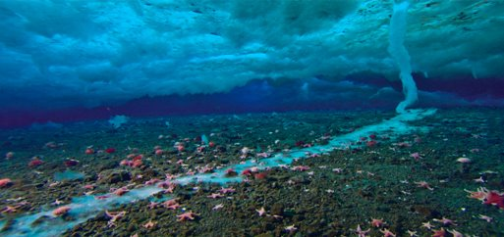
Introduction
A brinicle (brine icicle, also known as ice stalactite) is a downward-growing hollow tube of ice enclosing a plume of descending brine that is formed beneath developing sea ice.(Source: Wikipedia)​
The internship’s main goal was to build a pattern simulation of Brinicles formation process as it happens on the seabed of the Artic and the Antarctic

Slide 4
Why are we Modelling a Brinicle?
Brinicles effects the circulation of saltwater in oceans, especially in the equator. Thus, it indirectly influences global warming and rising sea levels
Heat flows through them thus they contribute to the energy balance in the ice pack of the Antarctic
There is also a theory of a cold origin of life on earth which involves Brinicles
Brinicles are found in very harsh and uninhabited regions.

Slide 5
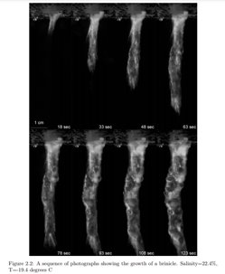
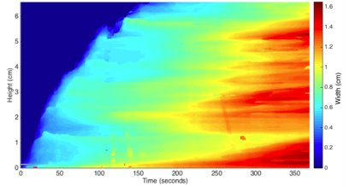
THE GROWTH AND DYNAMICS OF BRINICLES ​
The main source literature used to scientifically quantify and standardize variables was a senior thesis paper by a Harvard Graduate who carried out a controlled experiment to produce the Brinicle in a tank

Slide 6
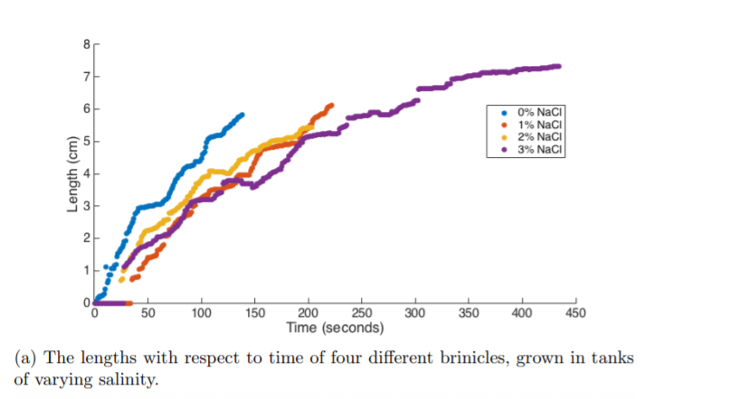
Expected Results(Length vs Time)
According to data from both the Harvard study(2017) and Martin publication(1974) both found experimentally that brinicle growth directly correlated with square root of time(length given in cm)
Throughout our work we changed our model appropriately to match the expected growth

Slide 7
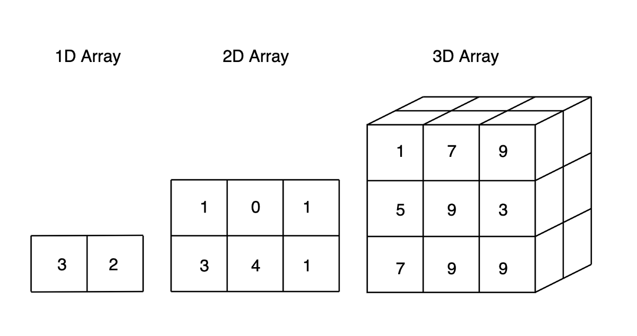
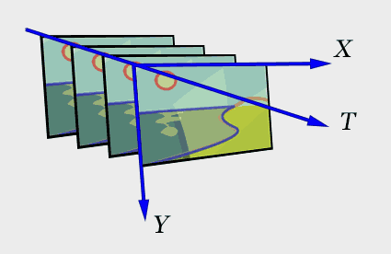
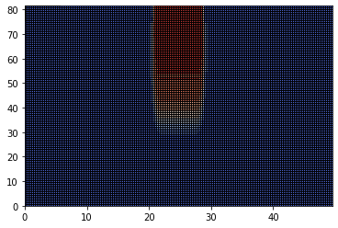
Point Models
Our Model Works Using third rank tensors (also known as 3D arrays)
The first and second dimension represent the x and y axis respectively
The third dimension represents time (like a flipbook

Slide 8
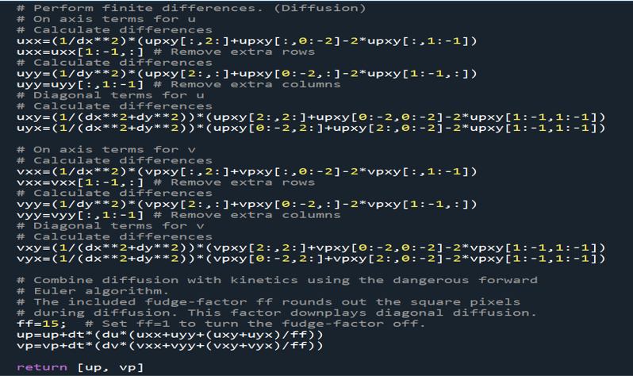
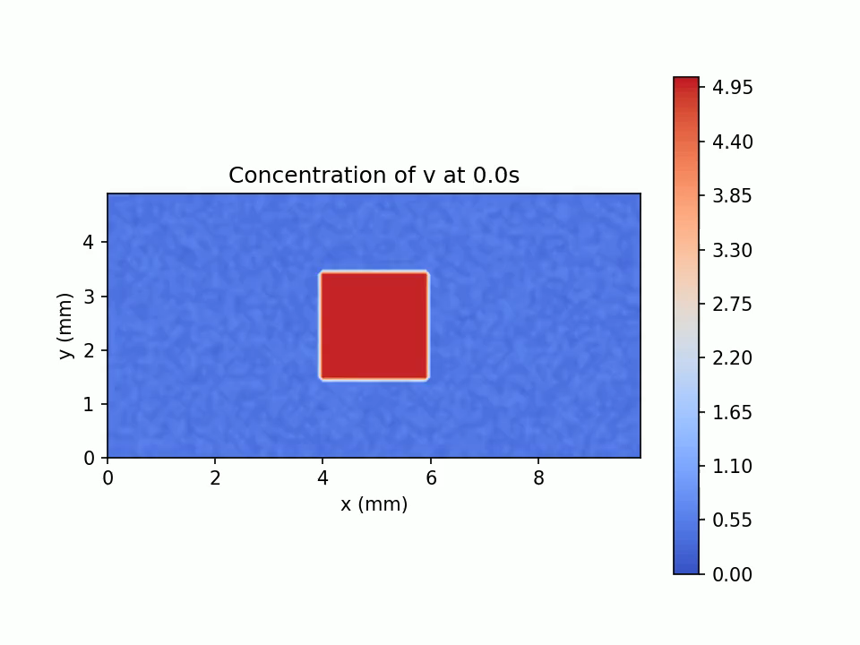
What is Diffusion?
Diffusion is the spreading out of a substance
Used in the model to spread out the concentrated brine and temperature
Video by Caleb Powell using code from Dr. Nate Tompkins
Code updated by Fardin using source code from Dr. Nate Tompkins​​
Video by Caleb Powell using code from Dr. Nate Tompkins​

Slide 9
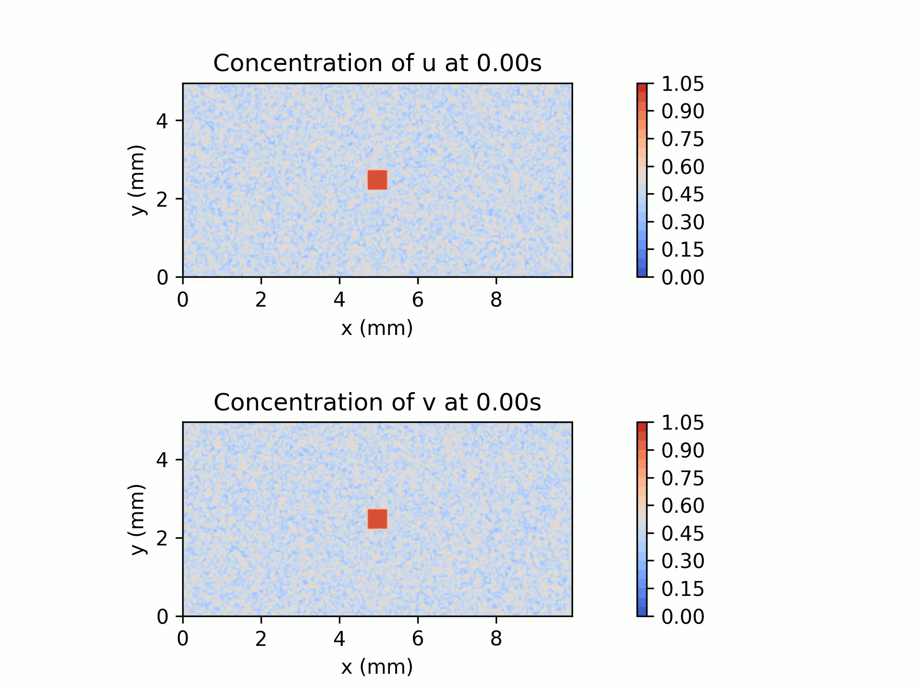
What is Advection?
Advection is the bulk movement of fluid in a specific direction
Used in the model to move brine and temperature vertically downwards
Video by Caleb Powell using code from Dr. Nate Tompkins

Slide 10
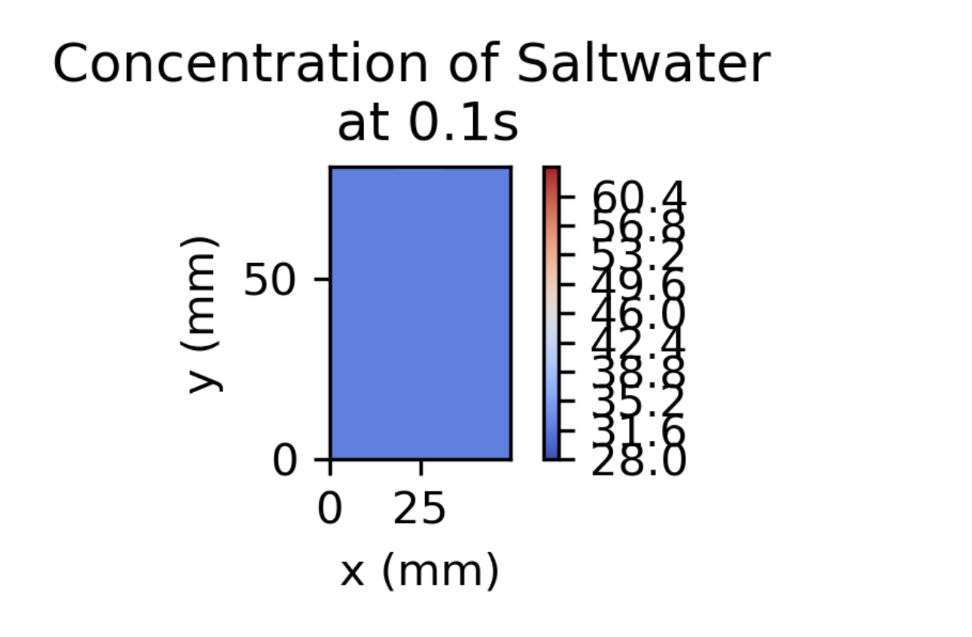
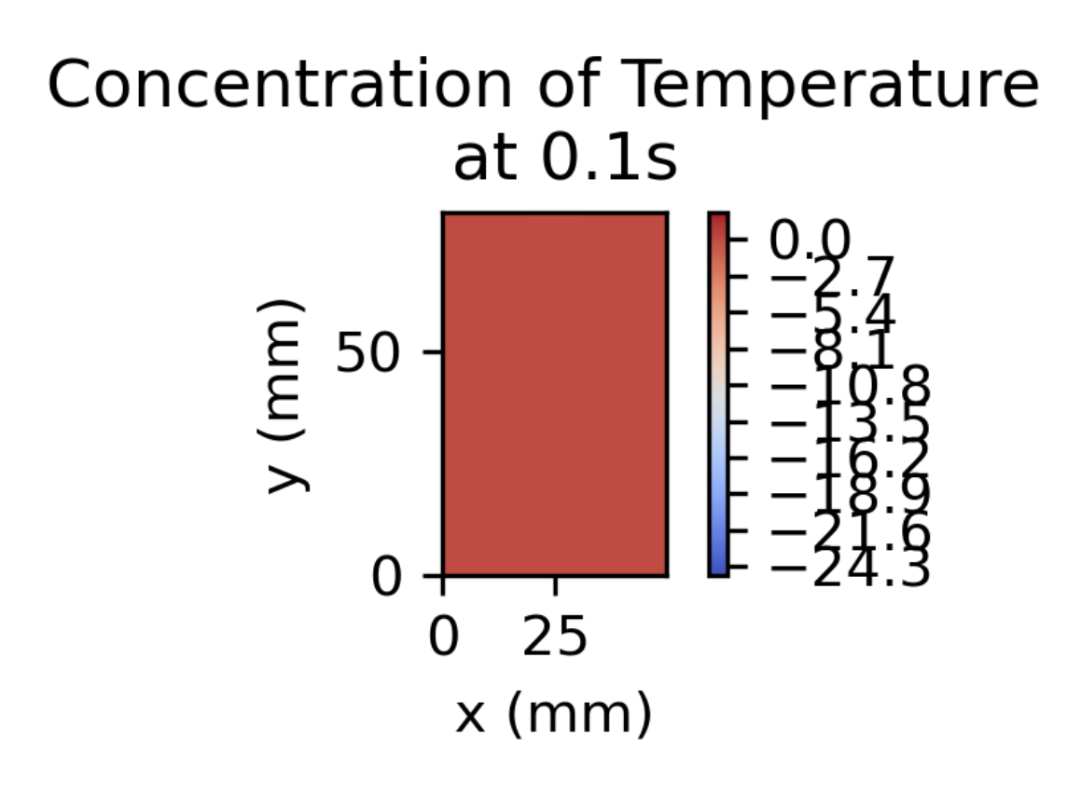
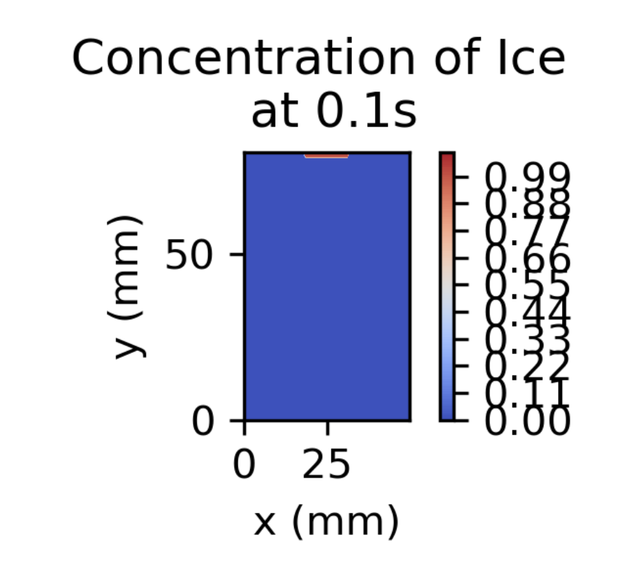
Physical Model
U = Brine Concentration
T = Temperature of Water
W = Ice (a Boolean)​

Slide 11

Constant Values
Brine Diffusion Rate = 0.002 ${mm}^{2}/s$
Temperature Diffusion Rate = 0.001 ${mm}^{2}/s$
Ocean salinity= 28 PSU (Practical Salinity Unit)
Brine salinity= 60+ PSU (Practical Salinity Unit)
Ocean Temperature = 0 C
Brine Temperature = -17 C

Slide 12
Advection Rate Based on Salinity
The more salt the water contains, the denser it becomes, and the quicker it should fall to the ocean floor (Downward Advection)
Since the Brine is Very cold and Very salty, as it moves down, it should bring its cold temperature with it
Thus, the advection rate of both brine and temperature should depend on the brine concentration at that point.
Salt Concentration plot Represented on its 164 x 100 grid space at time step 75s

Slide 13
Diffusion Barrier
A diffusion barrier that would stop saltwater and brine diffusing through ice
Each matrices multiplication is now applied separately rather than together
The formula used: du*(1 - w_center) * ( (1 - w_left) * (u_left - u_center) + (1 - w_right) * (u_right - u_center) )
du=rate of diffusion of saltwater
w=ice matric, u=saltwater matric

Slide 14
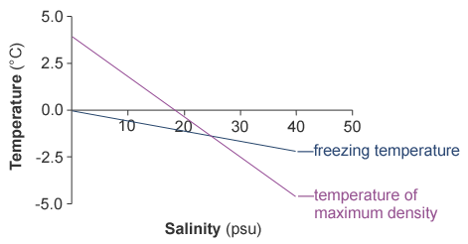
Freezing Point of ICE Based on Salt Concentration
The current temperature multiplied by the Salinity(PSU)/Temperature(◦C) ratio should give us the maximum concentration of salt we can have for freezing to still occur
The average salinity of the ocean typically varies from 32 to 37 PSU. For every 5 PSU increase in salinity, the freezing point decreases by 0.28 degrees Celsius

Slide 15
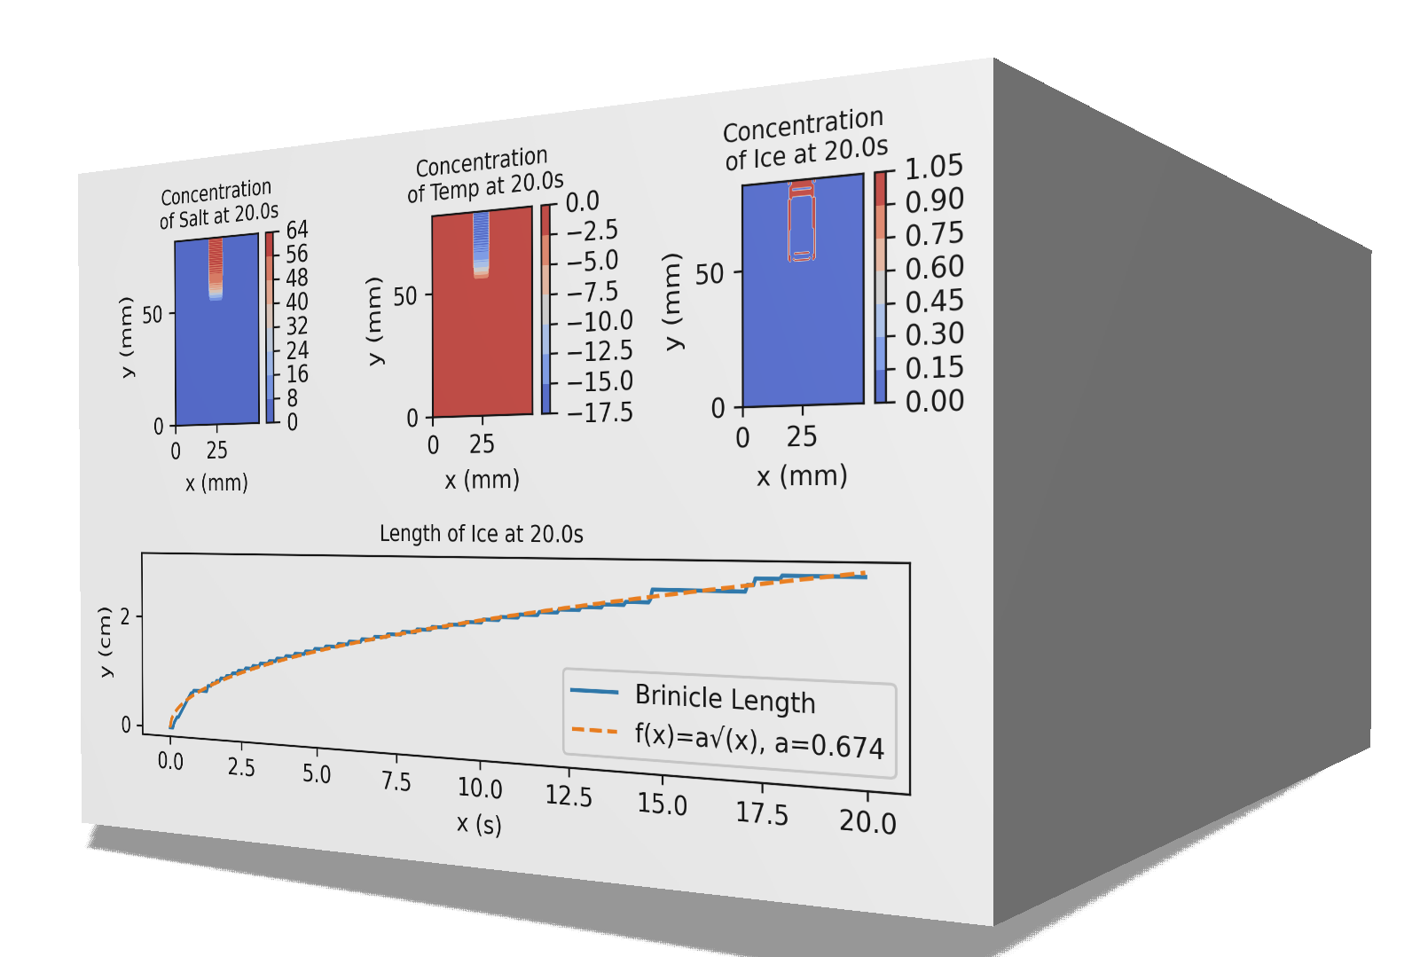
Improving Ram Usage and Runtime
As we increase our time step size and resolution, our arrays start to get very large.
If Lx = 50, Ly = 82, & res = 0.5, each of our two-dimensional arrays will be 100 x 164
If tEnd = 75s and dt = 0.05s, our array size would be 100 x 164 x 15,000!!!
This requires a lot of ram. What can we do?

Slide 16
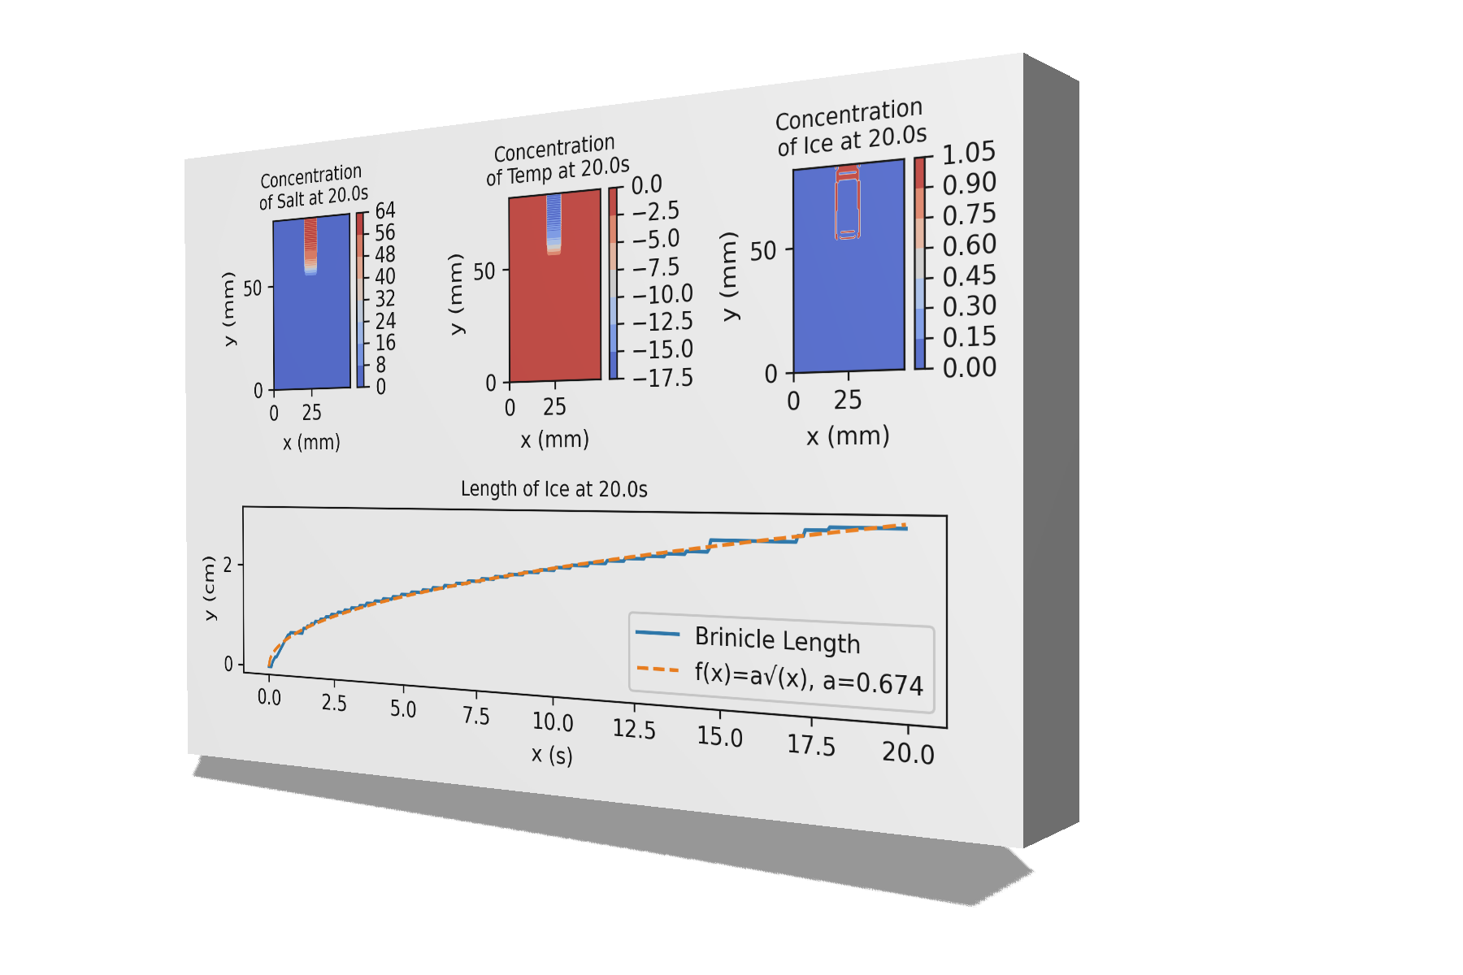
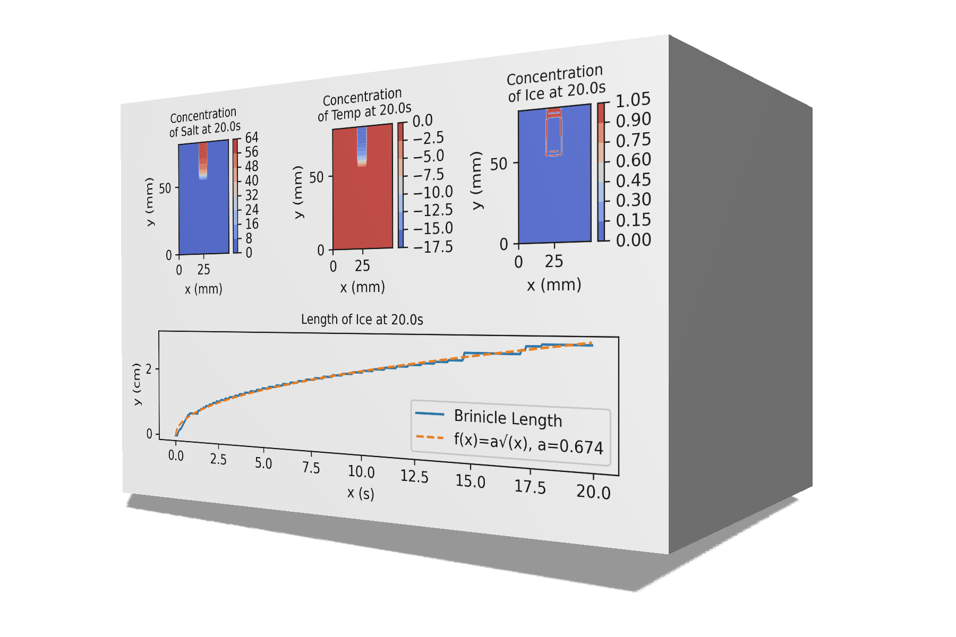
Improving Ram Usage and Runtime
Original
Lower dt value
Saving The Data in Chunks
Too Much Ram
Can’t Run High Resolution
Not as Accurate because it is calculating 1/10th as often
Potentially a good solution, but how often should we save? Interesting optimization problem

Slide 17

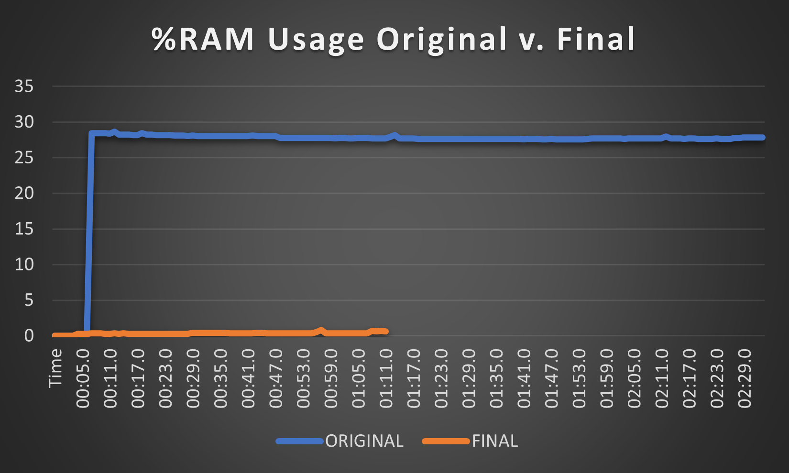
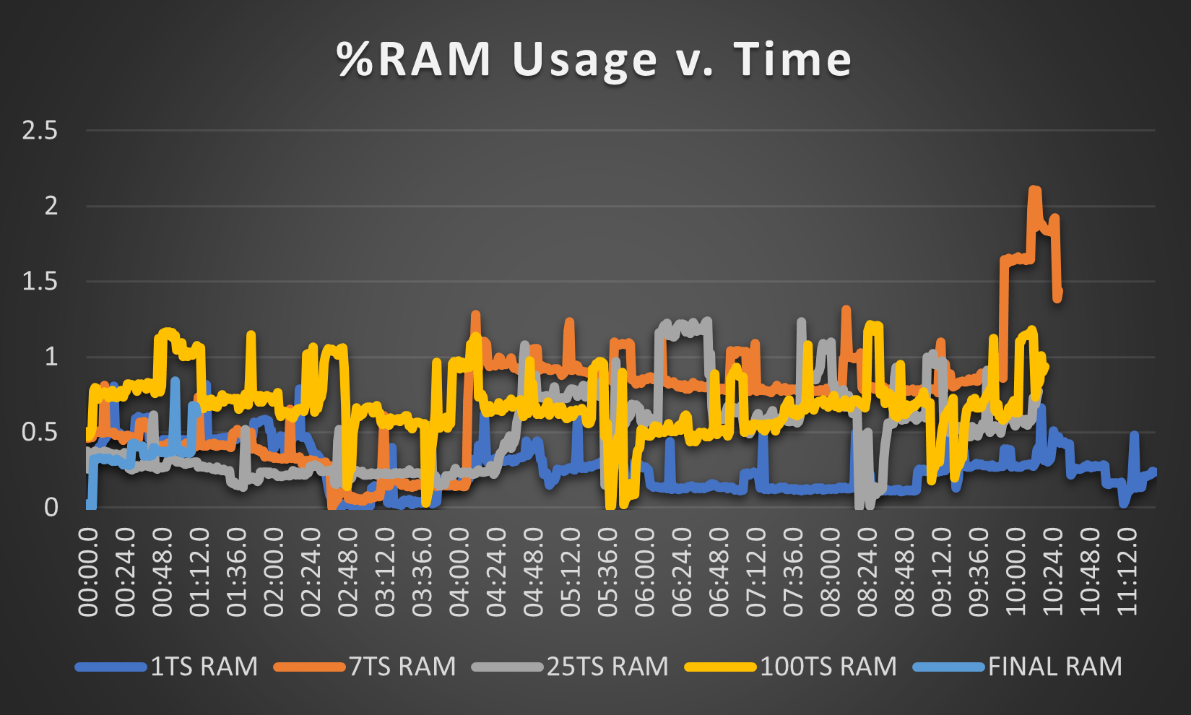
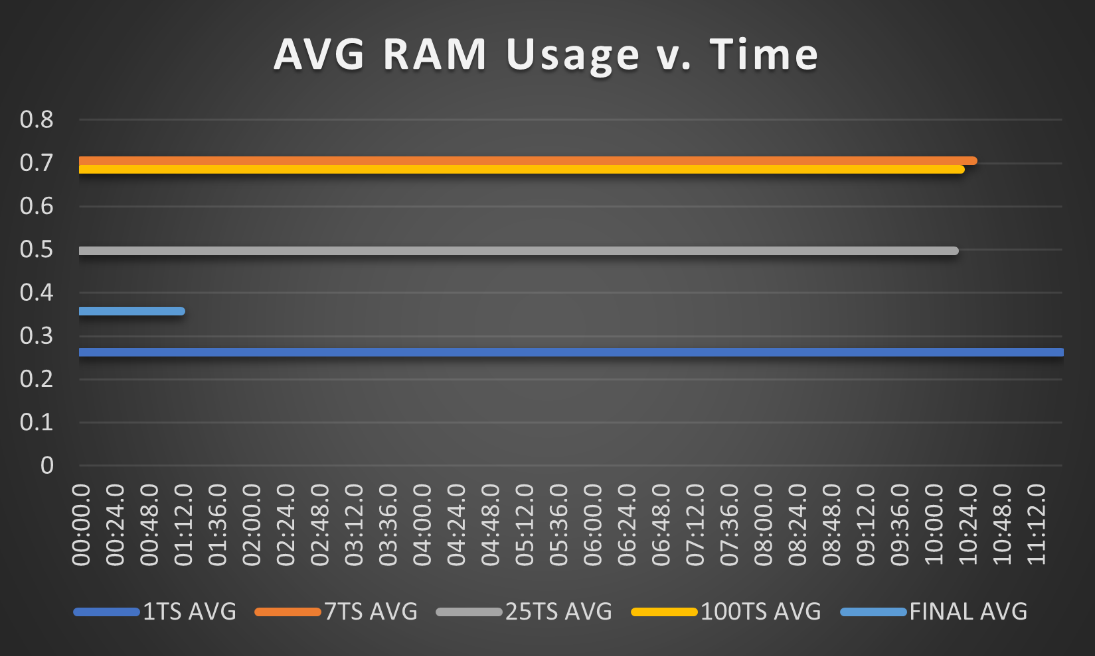
Improving Ram Usage and Runtime
Ultimately, Saving in chunks severely cut down the ram usage from ~28% to ~0.6%
However, our runtime went from 2:30 to 11:12 when saving every time step.
Saving turns out to be extremely slow. There must be a better way to do this. (Hence the line labeled Final)
Data Gathered using Windows 10 Performa

Slide 18
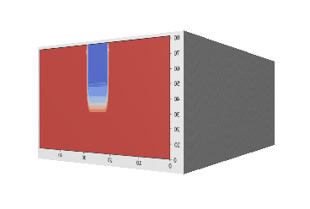
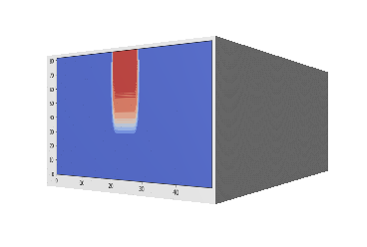
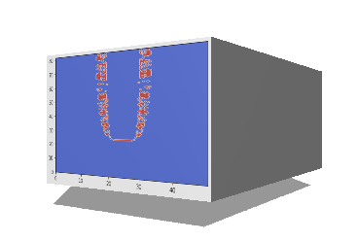
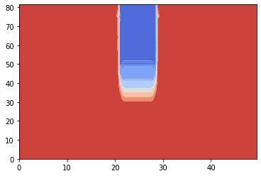
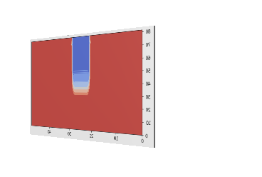
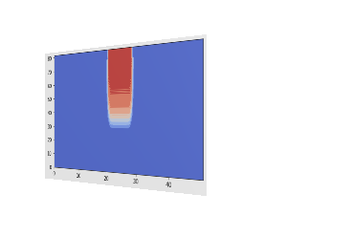
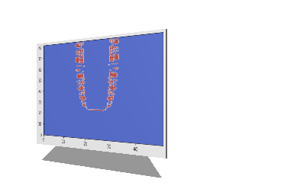
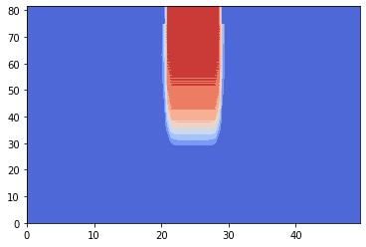
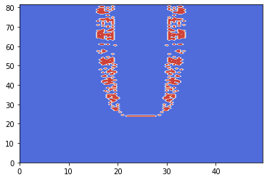

“OH, duh” Moment
Original
We are doing a calculation every 0.05 seconds, but we are only plotting every 0.5 seconds, so we only need to save the time steps that we are plotting
This means we can have (Lx,Ly) array for the u,T, & w concentration at the current time and a (Lx,Ly,t) array for only our plots
1/100th the Array size AND we don’t have to save
Takes Run time from 2:30 to 1:11 and Ram usage from ~28% to ~0.35%
Final

Slide 19
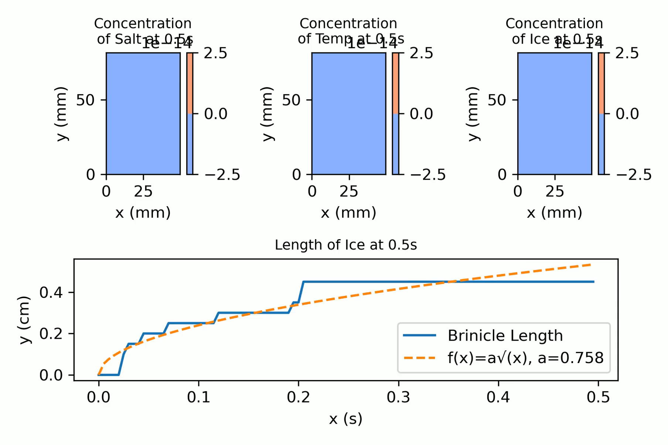
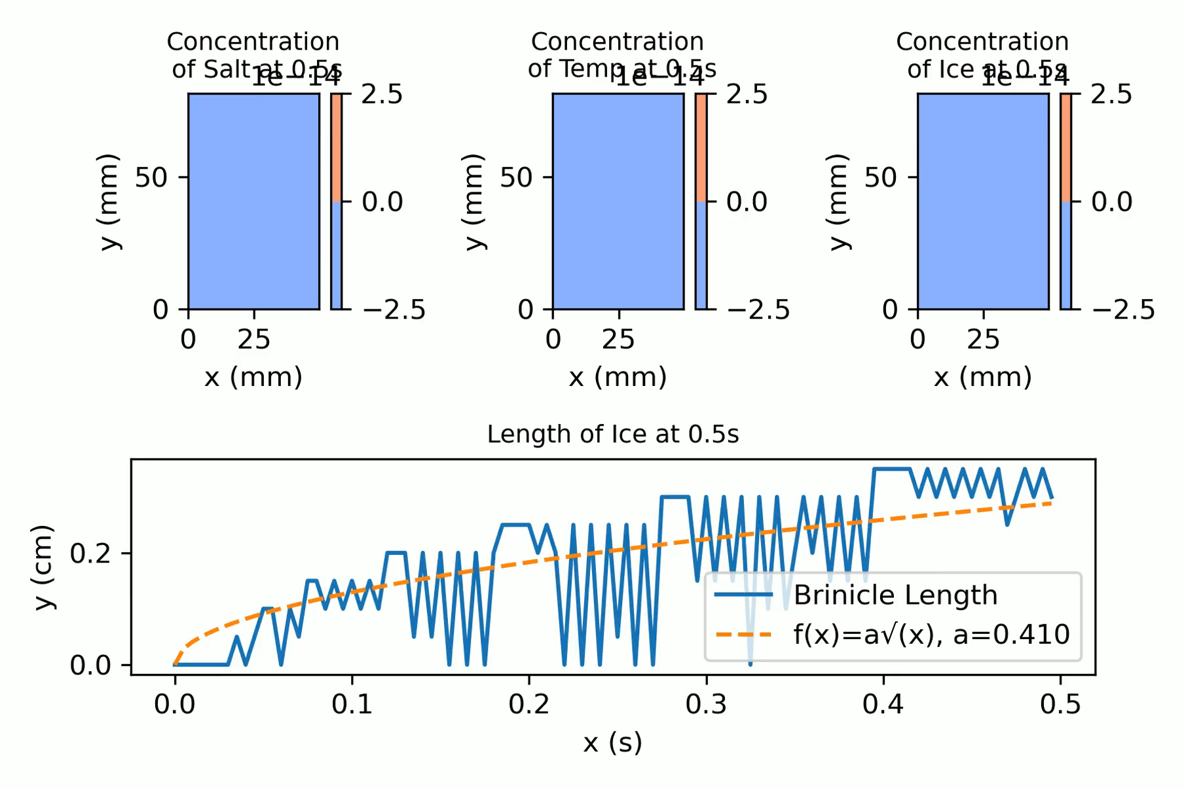
Final Simulation Results(Caleb)
No Melting
With Melting

Slide 20
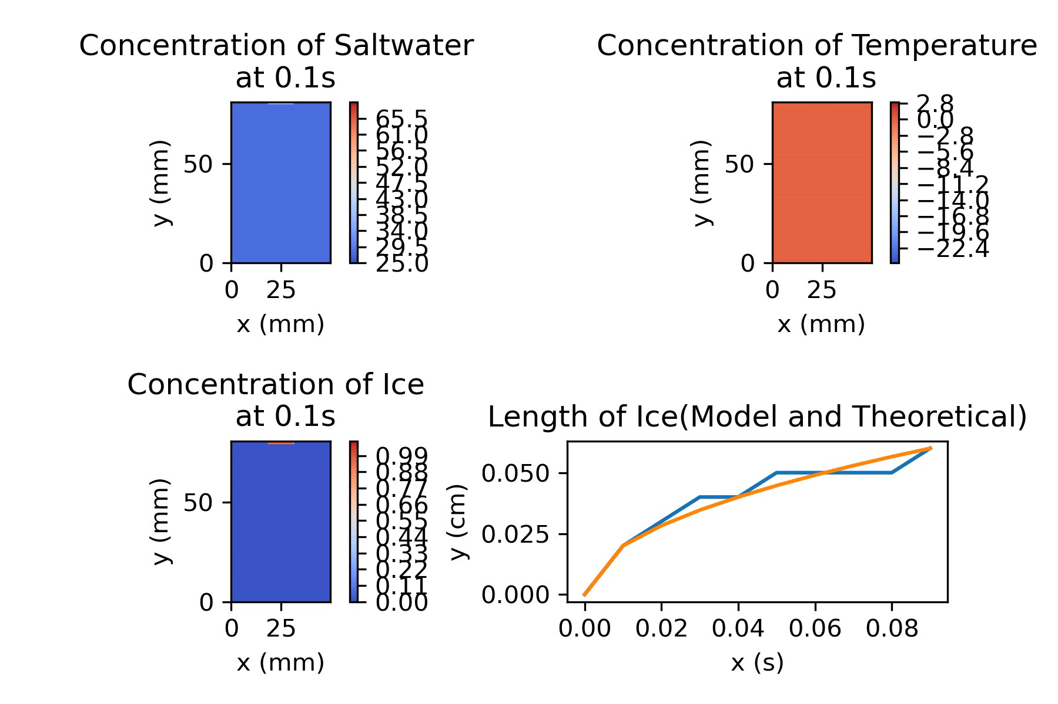

Final Simulation Results(Fardin)

Slide 21
Future
Ice more insulating than water
Floating ice
Diffusion based on temp

Slide 22
Paper Citations
https://nsidc.org/cryosphere/seaice/characteristics/brine_salinity.html
http://nrs.harvard.edu/urn-3:HUL.InstRepos:38811488
Julyan H. E. Cartwright, Bruno Escribano, Diego L. González, C. Ignacio Sainz-Díaz, and Idan Tuval Langmuir 2013 29 (25), 7655-7660 DOI: 10.1021/la4009703

